Slide 1
Chapter 25
Control of Body Temperature and Water Balance
0
Lecture by Richard L. Myers
Translated by Nabih A. Baeshen

Slide 2
Introduction: Chilling Out
Homeostasis
  Maintenance of steady internal conditions despite fluctuations in the external environment
Examples of homeostasis
  Thermoregulation—the maintenance of internal temperature within narrow limits
  Osmoregulation—the control of the gain and loss of water and solutes
  Excretion—the disposal of nitrogen-containing wastes
Copyright © 2009 Pearson Education, Inc.
Notes:
The concept of homeostasis may be new to some students, who have never considered how organisms maintain their structure and physiology. Analogies to other systems that engage in self-regulation can help, such as the water regulation of a toilet or the temperature regulation of a furnace.

Slide 3
THERMOREGULATION
Copyright © 2009 Pearson Education, Inc.

Slide 4
25.1 An animal’s regulation of body temperature helps maintain homeostasis
Thermoregulation
  The process by which animals maintain an internal temperature within a tolerable range
Ectothermic animals
  Absorb heat from their surroundings
  Many fish, most amphibians, lizards, most invertebrates
Endothermic animals
  Derive body heat mainly from their metabolism
  Birds, mammals, a few reptiles and fish, many insects
Copyright © 2009 Pearson Education, Inc.
Notes:
Student Misconceptions and Concerns
1. The concept of homeostasis may be new to students, who have never considered how organisms must adjust to subtle changes in environmental conditions. Analogies to other systems that engage in self-regulation, such as the water regulation of a toilet or the temperature regulation of a furnace, may help.
2. One role of the circulatory system rarely discussed is the transport of heat. Blood vessels near the surface of the body expand when we are overheated, releasing some of this excess to the environment. Conversely, during periods of exposure to cold, blood is shunted away from the skin to conserve heat.
Teaching Tips
1. The terms warm-blooded and cold-blooded are less precise than endotherm and ectotherm. Encourage students to discuss why the latter two terms are preferable.
2. Ask your students to explain the adaptive advantages of endothermy and ectothermy. You might prompt the discussion by noting that endotherms consume about 10 times as many calories as ectotherms of equivalent body mass. What advantages might be worth this additional “cost” for endotherms?
3. The heat generated by aerobic metabolism is analogous to the heat generated by the engine of an automobile. In both cases, the heat is a by-product of the process. In the winter, this excess heat helps keep the body and the interior of the car warm. In the summer, both the body and the automobile’s engine must work to keep from overheating.

Slide 5
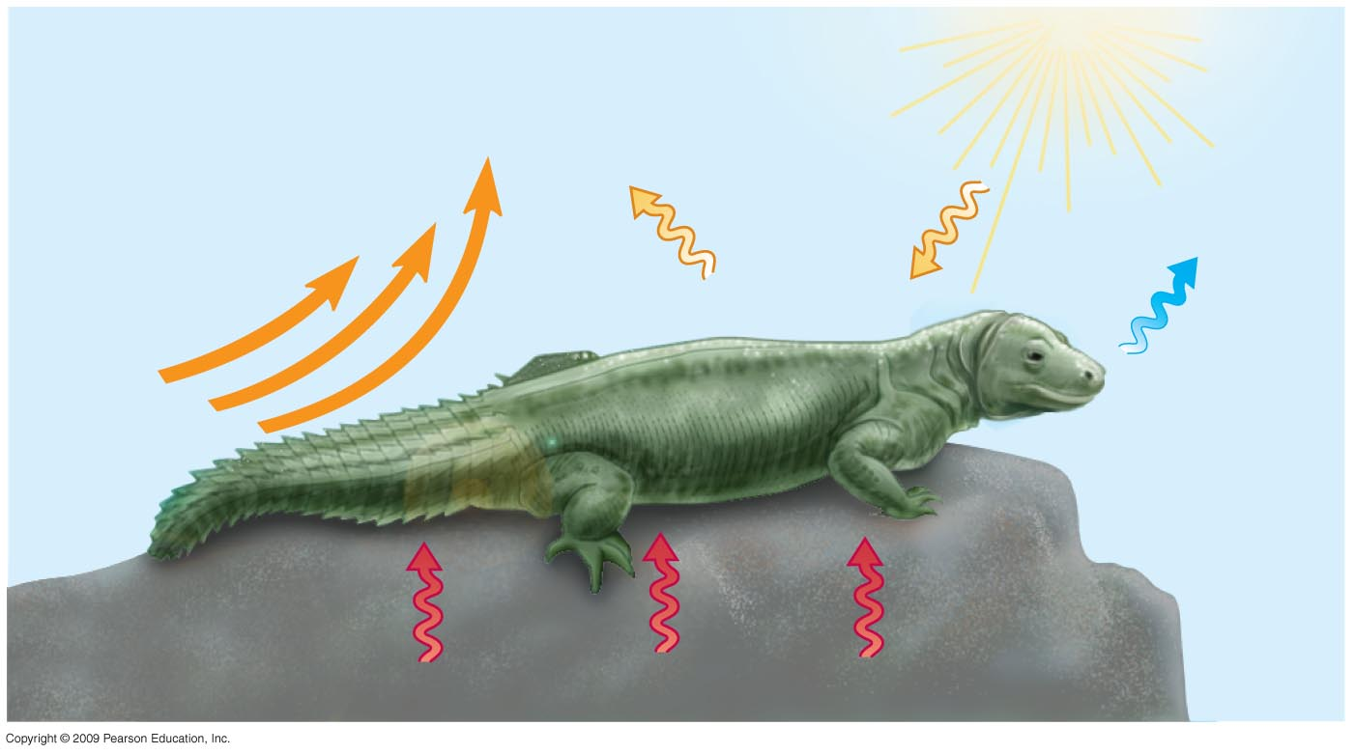
25.2 Heat is gained or lost in four ways
Heat exchange with the environment may occur by
  Conduction
  Convection
  Radiation
  Evaporation
Radiation
Evaporation
Convection
Mechanisms of heat exchange
Conduction
Copyright © 2009 Pearson Education, Inc.
Notes:
Student Misconceptions and Concerns
1. The concept of homeostasis may be new to students, who have never considered how organisms must adjust to subtle changes in environmental conditions. Analogies to other systems that engage in self-regulation, such as the water regulation of a toilet or the temperature regulation of a furnace, may help.
2. One role of the circulatory system rarely discussed is the transport of heat. Blood vessels near the surface of the body expand when we are overheated, releasing some of this excess to the environment. Conversely, during periods of exposure to cold, blood is shunted away from the skin to conserve heat.
Teaching Tips
1. Have students list the many factors that affect heat gain and loss during periods of physical activity, then have them identify which of the four physical processes for exchanging heat are involved. The factors include (a) the person’s physical condition, (b) the level of physical activity, (c) the age of the person (younger people tend to have higher metabolic rates), (d) the person’s level of hydration (which in turn affects the amount of sweating and evaporative cooling), (e) the external level of humidity (higher levels decrease evaporative cooling), (f) the intensity of the wind (greater intensity promotes evaporative cooling), (g) the intensity of sunlight, and (h) the color of the person’s clothing (which affects the amount of light energy the body absorbs).
2. You can extend the exercise above by challenging your class to identify environmental conditions when it would be too hot to play an outdoor sport. That is, when as a parent or coach would you want to prevent practice or a game because it is dangerously hot?
3. As an alternative to the above, challenge students to identify a human example of each of the four physical processes that involve heat exchange with the environment (Module 25.3) and that promote thermoregulation (Module 25.4). Or, to check student comprehension, describe such examples and challenge the class to match the examples to the correct terminology.

Slide 6
25.3 Thermoregulation involves adaptations that balance heat gain and loss
Five general categories of adaptations promote thermoregulation
1-Increased metabolic heat production
  Hormonal changes boost metabolic rate in birds and mammals
  Shivering
  Increased physical activity
  Honeybees cluster and shiver
Copyright © 2009 Pearson Education, Inc.
Notes:
Student Misconceptions and Concerns
1. The concept of homeostasis may be new to students, who have never considered how organisms must adjust to subtle changes in environmental conditions. Analogies to other systems that engage in self-regulation, such as the water regulation of a toilet or the temperature regulation of a furnace, may help.
2. One role of the circulatory system rarely discussed is the transport of heat. Blood vessels near the surface of the body expand when we are overheated, releasing some of this excess to the environment. Conversely, during periods of exposure to cold, blood is shunted away from the skin to conserve heat.
Teaching Tips
1. Have students list the many factors that affect heat gain and loss during periods of physical activity, then have them identify which of the four physical processes for exchanging heat are involved. The factors include (a) the person’s physical condition, (b) the level of physical activity, (c) the age of the person (younger people tend to have higher metabolic rates), (d) the person’s level of hydration (which in turn affects the amount of sweating and evaporative cooling), (e) the external level of humidity (higher levels decrease evaporative cooling), (f) the intensity of the wind (greater intensity promotes evaporative cooling), (g) the intensity of sunlight, and (h) the color of the person’s clothing (which affects the amount of light energy the body absorbs).
2. You can extend the exercise above by challenging your class to identify environmental conditions when it would be too hot to play an outdoor sport. That is, when as a parent or coach would you want to prevent practice or a game because it is dangerously hot?
3. As an alternative to the above, challenge students to identify a human example of each of the four physical processes that involve heat exchange with the environment (Module 25.3) and that promote thermoregulation (Module 25.4). Or, to check student comprehension, describe such examples and challenge the class to match the examples to the correct terminology.
4. Some students will be familiar with the type of foam insulation wrap surrounding interior pipes. These forms of insulation are especially necessary when hot- and cold water pipes run parallel and in close proximity to each other. Without the insulation, heat would be easily transferred from hot-water to cold-water pipes, in a situation similar to countercurrent heat exchange systems in animals.

Slide 7
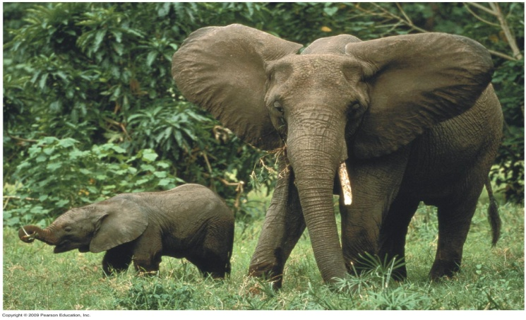
25.3 Thermoregulation involves adaptations that balance heat gain and loss
2- Insulation
  Hair
  Feathers
  Fat layers
3- Circulatory adaptations
  Increased or decreased blood flow to skin
  Large ears in elephants
  Countercurrent heat exchange
Copyright © 2009 Pearson Education, Inc.
Notes:
Student Misconceptions and Concerns
1. The concept of homeostasis may be new to students, who have never considered how organisms must adjust to subtle changes in environmental conditions. Analogies to other systems that engage in self-regulation, such as the water regulation of a toilet or the temperature regulation of a furnace, may help.
2. One role of the circulatory system rarely discussed is the transport of heat. Blood vessels near the surface of the body expand when we are overheated, releasing some of this excess to the environment. Conversely, during periods of exposure to cold, blood is shunted away from the skin to conserve heat.
Teaching Tips
1. Have students list the many factors that affect heat gain and loss during periods of physical activity, then have them identify which of the four physical processes for exchanging heat are involved. The factors include (a) the person’s physical condition, (b) the level of physical activity, (c) the age of the person (younger people tend to have higher metabolic rates), (d) the person’s level of hydration (which in turn affects the amount of sweating and evaporative cooling), (e) the external level of humidity (higher levels decrease evaporative cooling), (f) the intensity of the wind (greater intensity promotes evaporative cooling), (g) the intensity of sunlight, and (h) the color of the person’s clothing (which affects the amount of light energy the body absorbs).
2. You can extend the exercise above by challenging your class to identify environmental conditions when it would be too hot to play an outdoor sport. That is, when as a parent or coach would you want to prevent practice or a game because it is dangerously hot?
3. As an alternative to the above, challenge students to identify a human example of each of the four physical processes that involve heat exchange with the environment (Module 25.3) and that promote thermoregulation (Module 25.4). Or, to check student comprehension, describe such examples and challenge the class to match the examples to the correct terminology.
4. Some students will be familiar with the type of foam insulation wrap surrounding interior pipes. These forms of insulation are especially necessary when hot- and cold water pipes run parallel and in close proximity to each other. Without the insulation, heat would be easily transferred from hot-water to cold-water pipes, in a situation similar to countercurrent heat exchange systems in animals.

Slide 8
25.3 Thermoregulation involves adaptations that balance heat gain and loss
4- Evaporative cooling
  Sweating
  Panting
5- Behavioral responses
  Used by endotherms and ectotherms
  Examples
    Moving to the sun or shade
    Migrating
    Bathing
Copyright © 2009 Pearson Education, Inc.
Notes:
Student Misconceptions and Concerns
1. The concept of homeostasis may be new to students, who have never considered how organisms must adjust to subtle changes in environmental conditions. Analogies to other systems that engage in self-regulation, such as the water regulation of a toilet or the temperature regulation of a furnace, may help.
2. One role of the circulatory system rarely discussed is the transport of heat. Blood vessels near the surface of the body expand when we are overheated, releasing some of this excess to the environment. Conversely, during periods of exposure to cold, blood is shunted away from the skin to conserve heat.
Teaching Tips
1. Have students list the many factors that affect heat gain and loss during periods of physical activity, then have them identify which of the four physical processes for exchanging heat are involved. The factors include (a) the person’s physical condition, (b) the level of physical activity, (c) the age of the person (younger people tend to have higher metabolic rates), (d) the person’s level of hydration (which in turn affects the amount of sweating and evaporative cooling), (e) the external level of humidity (higher levels decrease evaporative cooling), (f) the intensity of the wind (greater intensity promotes evaporative cooling), (g) the intensity of sunlight, and (h) the color of the person’s clothing (which affects the amount of light energy the body absorbs).
2. You can extend the exercise above by challenging your class to identify environmental conditions when it would be too hot to play an outdoor sport. That is, when as a parent or coach would you want to prevent practice or a game because it is dangerously hot?
3. As an alternative to the above, challenge students to identify a human example of each of the four physical processes that involve heat exchange with the environment (Module 25.3) and that promote thermoregulation (Module 25.4). Or, to check student comprehension, describe such examples and challenge the class to match the examples to the correct terminology.
4. Some students will be familiar with the type of foam insulation wrap surrounding interior pipes. These forms of insulation are especially necessary when hot- and cold water pipes run parallel and in close proximity to each other. Without the insulation, heat would be easily transferred from hot-water to cold-water pipes, in a situation similar to countercurrent heat exchange systems in animals.

Slide 9
OSMOREGULATION
AND EXCRETION
Copyright © 2009 Pearson Education, Inc.

Slide 10
25.4 Animals balance the gain and loss of water and solutes through osmoregulation
Osmoconformers
  Have the same internal solute concentration as seawater
  Many marine invertebrates are osmoconformers
Osmoregulators control their solute concentrations
  Freshwater fishes
    Gain water by osmosis
    Excrete excess water
    Pump salt across their gills
Copyright © 2009 Pearson Education, Inc.
Notes:
Student Misconceptions and Concerns
1. The idea that a freshwater fish never drinks can be conceptually challenging, especially for students who have heard the old saying “drinks like a fish”! Consider introducing your discussion of osmoregulation with this remarkable and seemingly counterintuitive fact in order to generate interest.
Teaching Tips
1. Students may better understand the challenges of osmoregulation in freshwater fish if they are reminded of what occurs when humans soak their hands in water. Students will likely recall that this causes the skin on their hands to wrinkle, and some may have noticed that their skin wrinkles even faster in soapy water. Skin absorbs water by osmosis (just as a freshwater fish gains water). Oils on our skin reduce the influx of water. Soapy water, which washes away these oils, speeds up the process. The wrinkling occurs because the skin can expand only in certain areas, creating puckers.

Slide 11
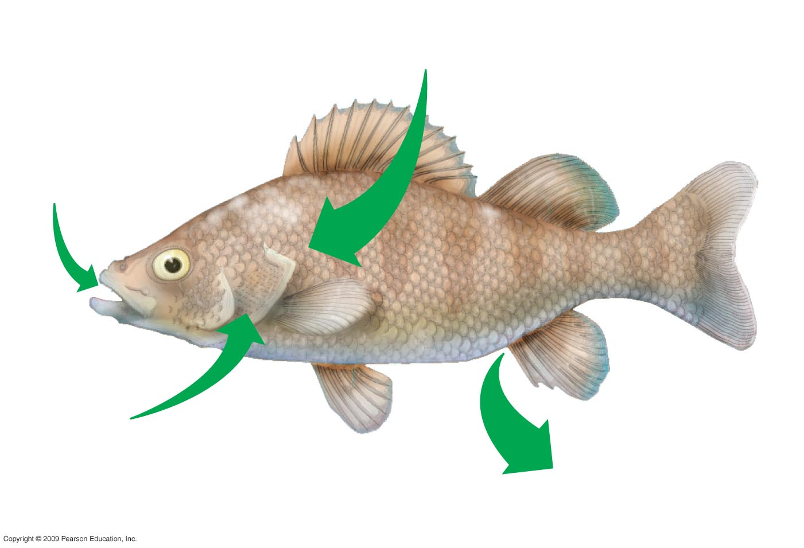
Osmotic water gain through gills
and other parts of body surface
Uptake of
some ions
in food
Excretion of
large amounts of
water in dilute
urine from kidneys
Uptake of
salt by
gills
Osmoregulation in a perch, a freshwater fish
Notes:
Figure 25.4A Osmoregulation in a perch, a freshwater fish.

Slide 12
25.4 Animals balance the gain and loss of water and solutes through osmoregulation
Saltwater fish
  Lose water by osmosis
  Drink seawater
  Pump out excess salt
Land animals
  Gain water by drinking and eating
  Lose water by evaporation and waste disposal
  Conserve water using
    Kidneys
    Behavior adaptations
    Waterproof skin
Copyright © 2009 Pearson Education, Inc.
Notes:
Student Misconceptions and Concerns
1. The idea that a freshwater fish never drinks can be conceptually challenging, especially for students who have heard the old saying “drinks like a fish”! Consider introducing your discussion of osmoregulation with this remarkable and seemingly counterintuitive fact in order to generate interest.
Teaching Tips
1. Students may better understand the challenges of osmoregulation in freshwater fish if they are reminded of what occurs when humans soak their hands in water. Students will likely recall that this causes the skin on their hands to wrinkle, and some may have noticed that their skin wrinkles even faster in soapy water. Skin absorbs water by osmosis (just as a freshwater fish gains water). Oils on our skin reduce the influx of water. Soapy water, which washes away these oils, speeds up the process. The wrinkling occurs because the skin can expand only in certain areas, creating puckers.

Slide 13
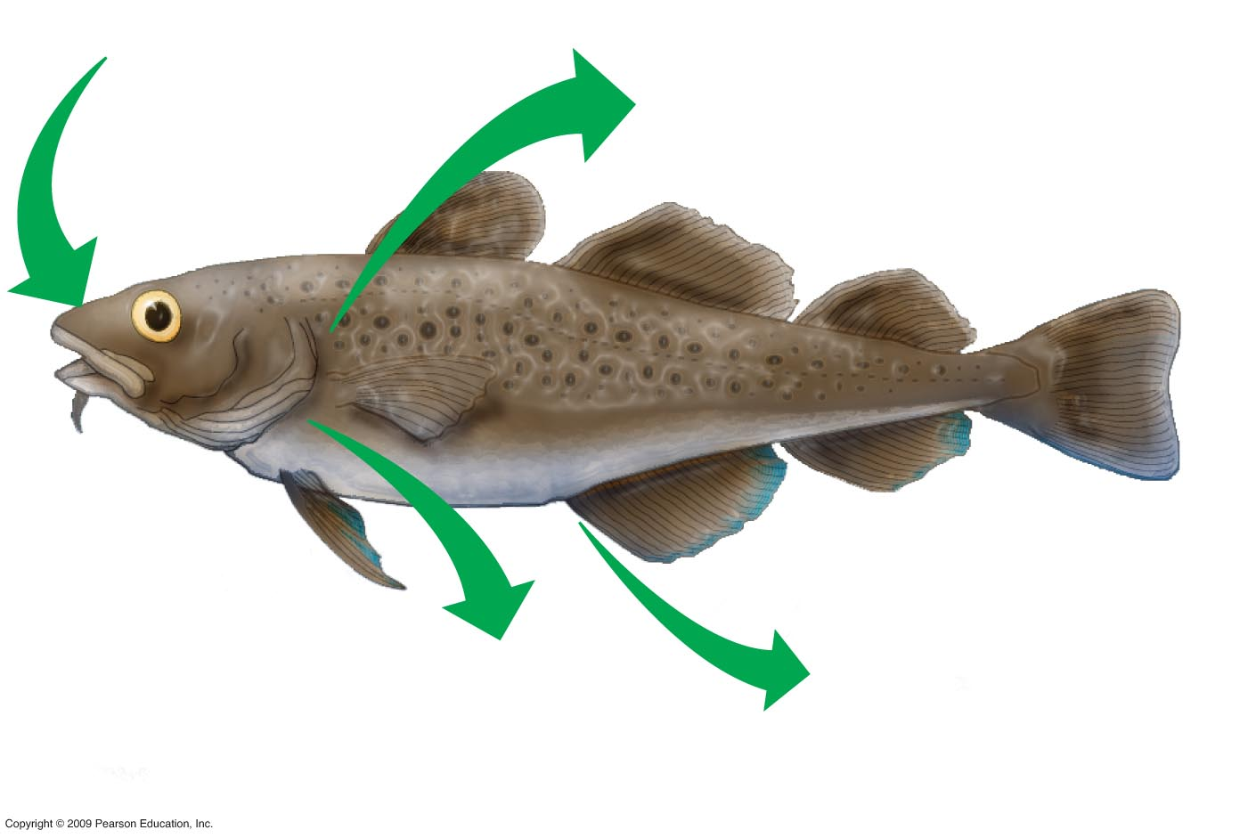
Gain of water and
salt from food
and by drinking
seawater
Osmotic water loss
through gills and other
parts of body surface
Excretion of excess
ions and small
amounts of water
in scanty urine
from kidneys
Excretion of
Salt from gills
Osmoregulation in a cod, a saltwater fish
Notes:
Figure 25.4B Osmoregulation in a cod, a saltwater fish.

Slide 14
25.5 EVOLUTION CONNECTION: A variety of ways to dispose of nitrogenous wastes have evolved in animals
Nitrogenous wastes are toxic breakdown products of protein
Animals dispose of nitrogenous wastes such as
1-Ammonia (NH3)
Poisonous
Soluble in water
Easily disposed of by aquatic animals
2- Urea
Less toxic
Easier to store
3- Some land animals save water by excreting uric acid relatively non toxic insoluble in water (dry waste excreated as semisolid)
Urea and uric acid take energy to produce
Copyright © 2009 Pearson Education, Inc.
Notes:
Student Misconceptions and Concerns
1. The kidney’s role in filtration and selective reabsorption may initially be confusing to many students. The process is a bit like cleaning up a closet by removing all the contents and then selectively returning to it what you wish to store.
Teaching Tips
1. Student experience with osmoregulation not pertaining to their own bodies may be quite limited. However, many students are familiar with the pasty white color of bird droppings. Consider beginning your discussion of nitrogenous wastes by asking your class to explain why bird droppings are white.

Slide 15
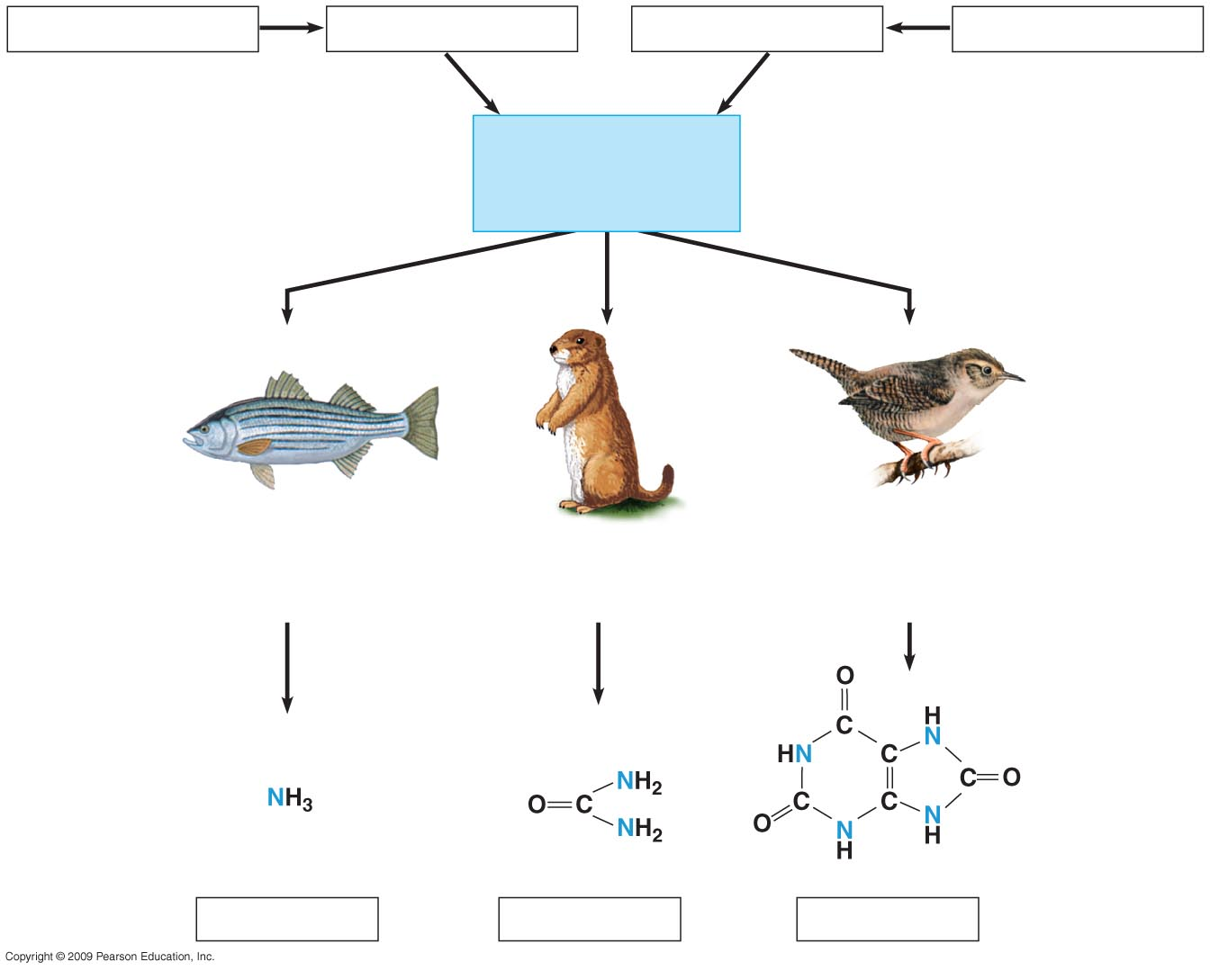
Proteins
Amino acids
Nitrogenous bases
Nucleic acids
—NH₂
Amino groups
Nitrogen-containing metabolic waste products
Most aquatic animals,
including most fishes
Mammals, amphibians,
sharks, some bony
fishes
Birds and many other
reptiles, insects, land
snails
Ammonia
Urea
Uric acid
Notes:
Figure 25.5 Nitrogen-containing metabolic waste products.

Slide 16
25.6 The urinary system plays several major roles in homeostasis
The excretory system
  Expels wastes
  Regulates water balance
  Regulates ion balance
Nephrons
  Functional units of the kidneys
  Extract a filtrate from the blood
  Refine the filtrate to produce urine
Urine
  Ureters drain the kidneys
  Stored in the urinary bladder
  Expelled through the urethra
Copyright © 2009 Pearson Education, Inc.
Notes:
Student Misconceptions and Concerns
1. The kidney’s role in filtration and selective reabsorption may initially be confusing to many students. The process is a bit like cleaning up a closet by removing all the contents and then selectively returning to it what you wish to store.
2. Before addressing the human urinary system, challenge each student in your class to explain how a drink of water may end up as urine. Consider having each students write out their answer on a 3 × 5 card in class. This quick survey will likely reveal misunderstandings that would otherwise be concealed by quiet students’ reluctance to speak up. Students might suggest that some sort of tube transports fluid from the digestive tract to the kidneys or urinary bladder. Such surveys provide a useful means of gauging the initial assumptions of your students as they approach a new subject.
Teaching Tips
1. A moderately full human urinary bladder holds about 500 ml (or 1 pint) of fluid. The bladder’s maximum capacity may be up to double that volume, although if overdistended, it may burst!
2. Students must understand that blood consists of two main components, cells and plasma. If your course has not covered Chapter 23, consider assigning Module 23.12 to ensure that they have this important background knowledge.
3. During the production of urine, blood cells remain within blood vessels, and components of the plasma are filtered out and selectively reabsorbed. Students may appreciate your making this important distinction early on in the discussion of renal functions.

Slide 17
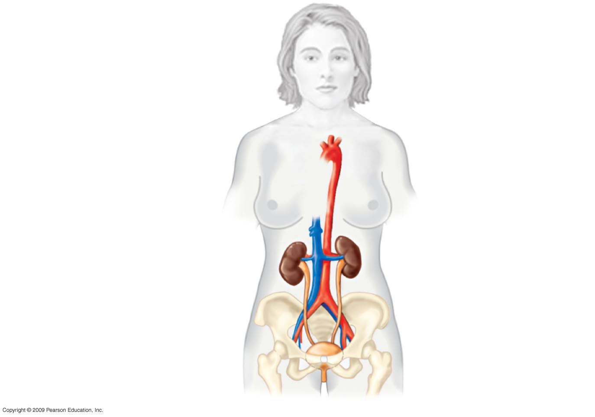
Anatomy of the human excretory system
Aorta
Inferior
vena cava
Renal artery and vein
Kidney
Ureter
Urinary bladder
Urethra
Notes:
Figure 25.6 Anatomy of the human excretory system. تشريح الجهاز الاخراجي في الانسان

Slide 18
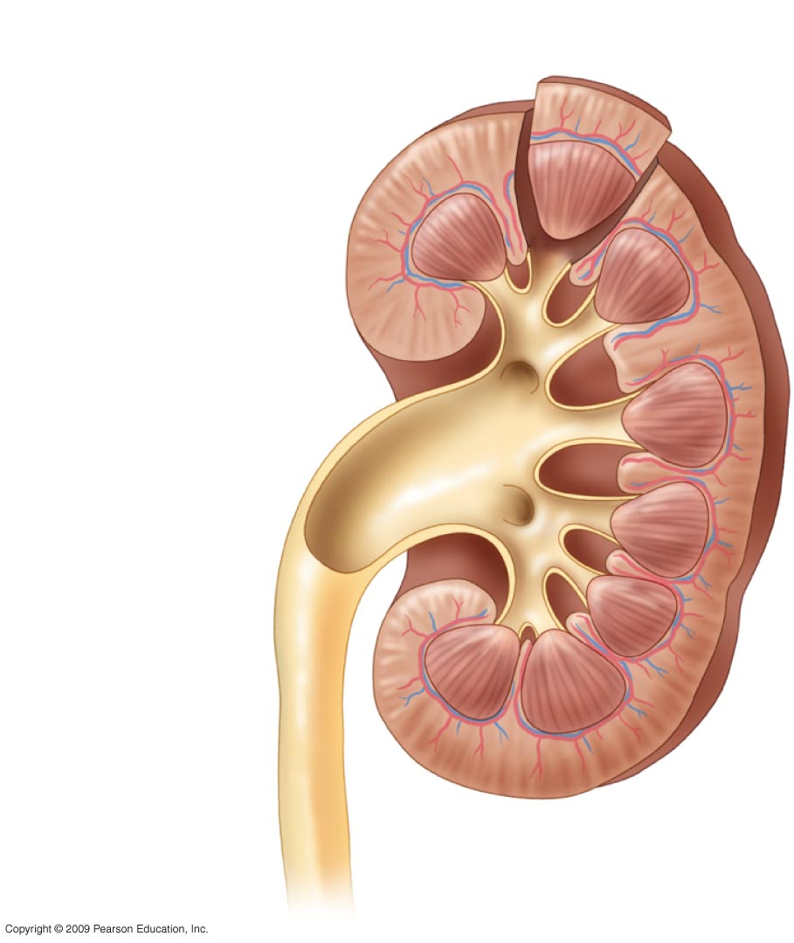
Renal cortex
Renal medulla
Renal pelvis
Ureter
Anatomy of the human excretory system (L.Sec. Kidney)
Notes:
Figure 25.6 Anatomy of the human excretory system. قطاع طولي في الكلية) )تشريح الجهاز الاخراجي في الانسان

Slide 19
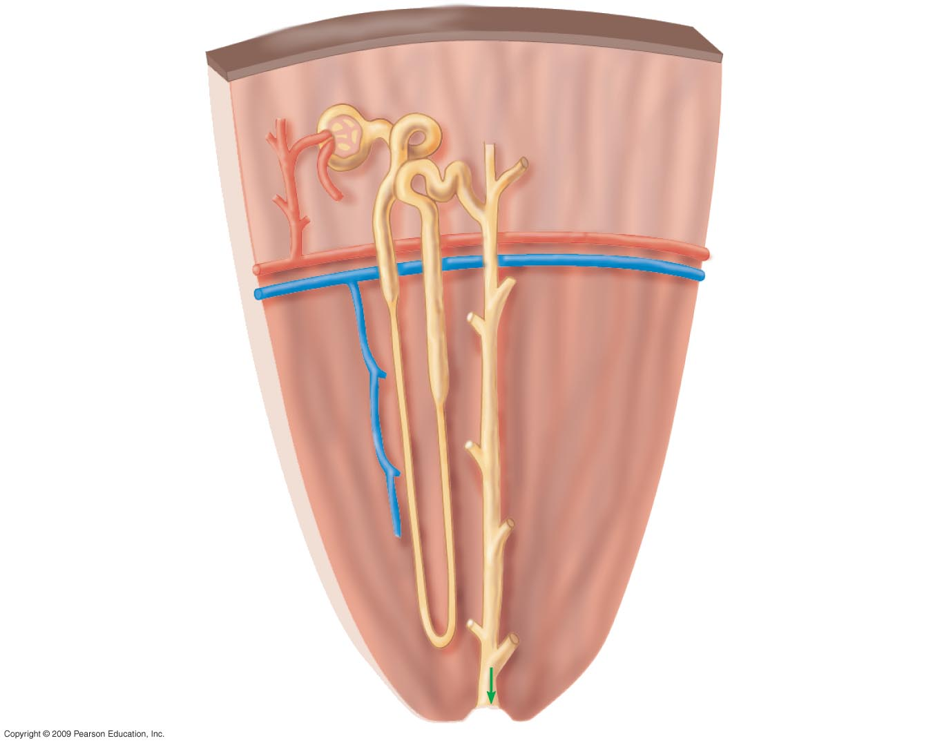
Bowman’s
Capsule
Tubule
Renal cortex
Renal artery
Renal vein
Collecting
Duct
Renal medulla
To
renal
Pelvis
Anatomy of the human excretory system C.Sec. Kidney
Notes:
Figure 25.6 Anatomy of the human excretory system. قطاع عرضي في الكلية) ) تشريح الجهاز الاخراجي في الانسان

Slide 20
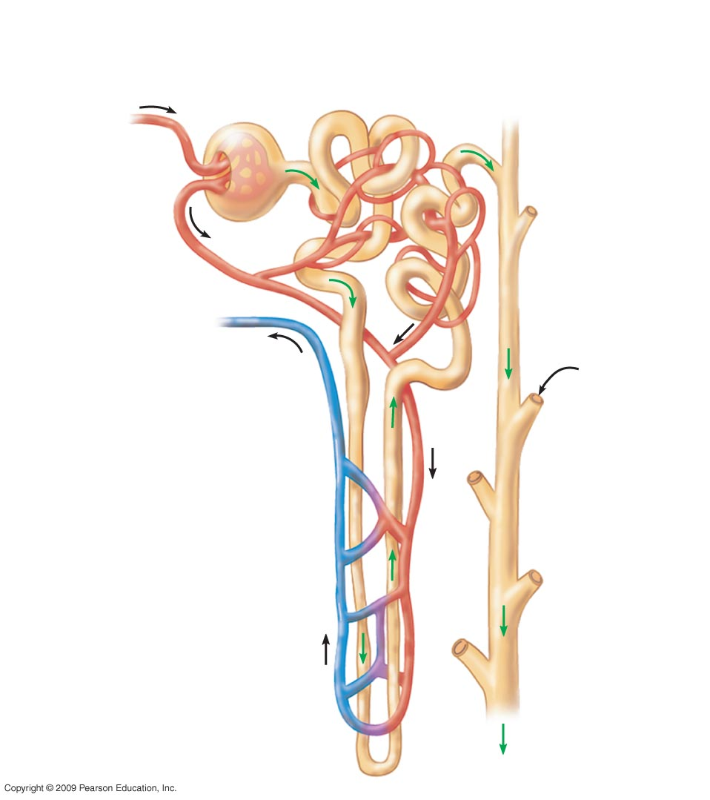
Bowman’s
capsule
Glomerulus
1
Proximal tubule
Arteriole
from renal
artery
Capillaries
Arteriole
from
glomerulus
3
Distal
Tubule
Branch of
renal vein
From
another
Nephron
Collecting
Duct
2
Loop of Henle
with capillary
network
Anatomy of the human excretory system (Diagram of a Nephron)
Notes:
Figure 25.6 Anatomy of the human excretory system. رسم توضيحي للوحدة البولية)) تشريح الجهاز الاخراجي في الانسان

Slide 21
25.7 Overview: The key processes of the urinary system are filtration, reabsorption, secretion, and excretion
Filtration
  Blood pressure forces water and many small solutes into the nephron tubules
Reabsorption: in the proximal and distal tubules
  Valuable solutes are return to the blood from the filtrate(e.g glucose ,salts ,amino acids and ions)
Secretion
  Excess H⁺ and toxins are added from the blood to the filtrate
Excretion
  The final product, urine, is excreted via ureters, urinary bladder , and urethera
Copyright © 2009 Pearson Education, Inc.
Notes:
Student Misconceptions and Concerns
1. The kidney’s role in filtration and selective reabsorption may initially be confusing to many students. The process is a bit like cleaning up a closet by removing all the contents and then selectively returning to it what you wish to store.
Teaching Tips
1. Students must understand that blood consists of two main components, cells and plasma. If your course has not covered Chapter 23, consider assigning Module 23.12 to ensure that they have this important background knowledge.
2. During the production of urine, blood cells remain within blood vessels, and components of the plasma are filtered out and selectively reabsorbed. Students may appreciate your making this important distinction early on in the discussion of renal functions.
3. Some drugs are excreted in urine. This is the basis of drug testing using samples of a person’s urine. Making this simple connection can help generate interest and improve comprehension in your students.

Slide 22
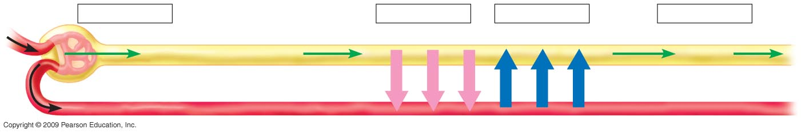
Filtration
Reabsorption
Secretion
Excretion
Nephron tubule
H₂O, other small molecules
Urine
Interstitial fluid
Capillary
Major processes of the urinary system
Notes:
Figure 25.7 Major processes of the urinary system. العلميات الرئيسية للجهاز البولي

Slide 23
25.8 Blood filtrate is refined to urine through reabsorption and secretion
pH is regulated by
  Reabsorption of HCO₃–
  Secretion of H⁺
Antidiuretic hormone (ADH) regulates the amount of water excreted by the kidneys
It regulate water balance in the body by increase water reabsorption from the kidney.
Copyright © 2009 Pearson Education, Inc.
Notes:
Student Misconceptions and Concerns
1. The kidney’s role in filtration and selective reabsorption may initially be confusing to many students. The process is a bit like cleaning up a closet by removing all the contents and then selectively returning to it what you wish to store.
Teaching Tips
1. Some drugs are excreted in urine. This is the basis of drug testing using samples of a person’s urine. Making this simple connection can help generate interest and improve comprehension in your students.
2. Students may be particularly interested in the diuretic effects of alcohol and caffeine. The text notes that the diuretic effects of alcohol may contribute to some of the symptoms of a hangover. However, the concentration of alcohol and caffeine are important factors. Higher urine output resulting from the high consumption of low-alcohol (1–5%) beer may largely be the consequence of increased water consumption. Drinks with higher alcohol levels, such as shots of hard liquor (gin, vodka, whiskey) or higher caffeine levels (espresso) and low fluid volume would be expected to better reveal the diuretic effects.

Slide 24
25.9 CONNECTION: Kidney dialysis can be a lifesaver
Compensating for kidney failure
A dialysis machine
  Removes wastes from the blood
  Maintains its solute concentration
Copyright © 2009 Pearson Education, Inc.
Notes:
Student Misconceptions and Concerns
1. The kidney’s role in filtration and selective reabsorption may initially be confusing to many students. The process is a bit like cleaning up a closet by removing all the contents and then selectively returning to it what you wish to store.
Teaching Tips
1. It is well established that the loss of one kidney in a human results in enlargement of the remaining kidney, a process known as compensatory hypertrophy. As your time permits, this can provide material for a class discussion or for a special-topic assignment for students with a particular interest.
2. The unfortunate shortage of kidneys and other organs available for transplant is a major health issue. Consider discussing this problem with your class. Many state and federal organ donation organizations can by located by a quick Internet search. The National Kidney Foundation site www.kidney.org/atoz/atozTopic.cfm?topic=11, includes information on kidney donation.

Slide 25
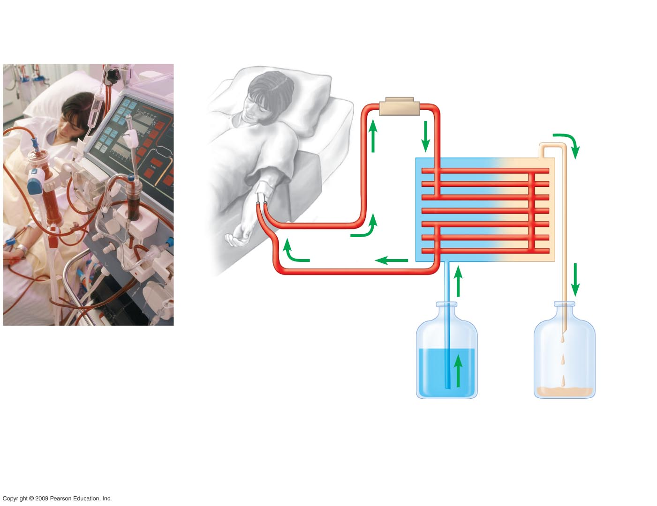
Line from artery
to apparatus
Pump
Tubing made of a
selectively permeable
membrane
Dialyzing
solution
Line from
apparatus
to vein
Fresh dialyzing
solution
Used dialyzing
solution
(with urea and
excess ions)
Kidney dialysis.
Notes:
Figure 25.9 Kidney dialysis. عملية غسل الكلى

Slide 26
You should now be able to
1- Explain how bear physiology adjusts during dormancy
2- Describe four ways that heat is gained or lost by an animal
3-Describe five categories of adaptations that help animals thermoregulate
4- Compare the osmoregulatory problems of freshwater fish, saltwater fish, and terrestrial animals
5- Compare the three ways that animals eliminate nitrogenous wastes
6- Describe the structure of the human kidney
7- Explain how the kidney promotes homeostasis
8 - Describe four major processes that produce urine
9- Describe the key events in the conversion of filtrate into urine
Copyright © 2009 Pearson Education, Inc.

Slide 27
Control of Body Temperature and Water Balance
التحكم في درجة حرارة الجسم و الاتزان المائي
المصطلـــــــــــــــــــــــــــــــــح | تعريف المصطلــــــــــح
Homeostasis | الاتزان الحيوي
Maintenance Of Steady Internal Conditions | القدرة على الحفاظ على ظروف وأحوال داخلية مستقرة
Fluctuations | التقلبات
Thermoregulation | التنظيم الحراري
Osmoregulation | التنظيم الاسموزي
Excretion | لاخراج
Nitrogen-Containing Wastes | المخلفات المحتوية على النتروجين
Thermoregulation | التنظيم الحراري
Internal Temperature Within A Tolerable Range | المحافظة على درجة حرارة الجسم الداخلية ضمن مدى يمكن تحمله
Ectothermic | خارجية الحرارة
Endothermic | داخلية الحرارة
Conduction | التوصيل
Convection | الحمل الحراري
Radiation | الاشعاع
Evaporation | التبخير

Slide 28
Control of Body Temperature and Water Balance
التحكم في درجة حرارة الجسم و الاتزان المائي
المصطلـــــــــــــــــــــــــــــــــح | تعريف المصطلــــــــــح
Mechanisms Of Heat Exchange | اليات تبادل الحرارة
Adaptations Promote Thermoregulation | التكيفات التي تشجع على التنظيم الحراري
Increased Metabolic Heat Production | زيادة انتاج الحرارة الايضية
Insulation | العزل
Circulatory Adaptations | التكيفات الخاصة بالدورة الدموية
Evaporative Cooling | التبريد بالتبخر
Sweating | التعرق
Panting | للهث
Behavioral Responses | الاستجابات السلوكية
Osmoregulation And Excretion | التنظيم الاسموزي والإخراج
Osmoconformers | الكائنات ذات التوافق الاسموزي
Same Internal Solute Concentration As Seawater | نفس تركيز المواد الذائبة الداخلية كمياه البحر
Marine Invertebrates Are Osmoconformers | اللافقاريات البحرية كائنات ذات توافق اسموزي

Slide 29
Control of Body Temperature and Water Balance
التحكم في درجة حرارة الجسم و الاتزان المائي
المصطلـــــــــــــــــــــــــــــــــح | تعريف المصطلــــــــــح
Osmoregulators Control Their Solute Concentrations | الكائنات ذات التنظيم الاسموزي لها القدرة على التحكم في تراكيز موادها المذابة
Saltwater Fish | اسماك المياه المالحة
Land Animals | حيوانات اليابسة
Nitrogenous Wastes | المخلفات النتروجينية
1-Ammonia (Nh3) | ) امونيا (غاز النشادر
Urea | البولينا
Excretory System | الجهاز الاخراجي
Expels Wastes | يطرد المخلفات
Regulates Water Balance | ينظم الاتزان المائي
Regulates Ion Balance | ينظم الاتزان الايوني
Nephrons | (النفرونات) الوحدات البولية
Functional Units Of The Kidneys | الوحدات الوظيفية للكلى
Extract A Filtrate From The Blood | استخلاص المواد الراشحة من الدم
Refine The Filtrate To Produce Urine | تنقية المواد الراشحة لإنتاج البول
Urine | البول

Slide 30
Control of Body Temperature and Water Balance
التحكم في درجة حرارة الجسم و الاتزان المائي
المصطلـــــــــــــــــــــــــــــــــح | تعريف المصطلــــــــــح
Ureters Drain The Kidneys | يفرغ الحالبان الكليتين
Stored In The Urinary Bladder | يخزن في المثانة البولية
Expelled Through The Urethra | يطرح من خلال المجرى البولي
Filtration | الترشيح
Blood Pressure Forces Water And Many Small Solutes Into The Nephron | يدفع ضغط الدم الماء و العديد من المواد المذابة الصغيرة الى الوحدة البولية
Reabsorption | اعادة الامتصاص
Valuable Solutes Are Reclaimed From The Filtrate | يتم استعادة المواد الذائبة النافعة من الراشح
Secretion | الافراز
Excess H⁺ And Toxins Are Added To The Filtrate | يضاف الفائض من ايون الهيدروجين و السموم الى الراشح
Excretion | الاخراج
Final Product, Urine, Is Excreted | اخراج المنتج النهائي وهو البول
Reabsorption In The Proximal And Distal Tubules Removes Nutrients, Salt, Water | يزيح اعادة الامتصاص في الانيببات القريبة والبعيدة المواد المغذية والملح والماء
Ph Is Regulated By | يتم تنظيم الاس الهيدروجيني

Slide 31
Control of Body Temperature and Water Balance
التحكم في درجة حرارة الجسم و الاتزان المائي
المصطلـــــــــــــــــــــــــــــــــح | تعريف المصطلــــــــــح
High Nacl Concentration | تركيز كلوريد الصوديوم العالي
Antidiuretic Hormone (ADH) | الهرمون المضاد للتبول
Regulates The Amount Of Water Excreted By The Kidneys | ينظم كمية الماء التي يتم التخلص منها عن طريق الكليتين
Compensating For Kidney Failure | التعويض عن الفشل الكلوي
A Dialysis Machine | جهاز غسل الكلى
Removes Wastes From The Blood | ازاحة المخلفات من الدم
Solute Concentration | تركيز المواد المذابة
Excretion In Plants | الإخراج فى النبات
Excretion Of Gases | إخراج الغازات
Exit | لخروجه
Penetrate External Cell Surfaces | النفاذ مباشرة عبر سطوح الخلايا الخارجية
Guttation | الإدماع

Slide 32
Control of Body Temperature and Water Balance
التحكم في درجة حرارة الجسم و الاتزان المائي
المصطلـــــــــــــــــــــــــــــــــح | تعريف المصطلــــــــــح
Secretion | إفراز
Hydathodes | الثغور المائية
Humid Environment. | البيئة الرطبة
Terrestrial Plants | النباتات الأرضية
Deamination | بعملية نزع الأمين
Aquatic Plants | النباتات المائية
Converted | تحويل
Salt Glands | بالغدد الملحية
Halophytes | غدد ملحية

